Slide 1
Template for the
Storyboard stage

Slide 2
General Instructions:
The template shown is an example. You can add more slides if required.
Include images for explaining the concepts.
Label the images.
Clearly list out the user interactions planned.

Slide 3
Prepare a questionnaire with answers on the concept for self-assessment of the user.
If reviewer suggests modifications, you have to re-upload your storyboard with the modifications shown in bold letters.
The blue band at the bottom will have suggestions about the slide contents.

Slide 4
Memory Allocation Policies
Animation Medium:- 2 Dimensional.
Software Used:- Java.
Mention what will be your animation medium: 2D or 3D
Mention the software to be used for animation development: JAVA, Flash, Blender, Shikav, Maya..etc

Slide 5
Memory Allocation Policies
Concept:- Memory Allocation policies viz.
Next fit, Best fit, Worst fit.
Subject:- Operating Systems.
Authors:-
  Aniket Phatak.
  Ameya Gawde.
  Daishik Mehta.
1
Title of the concept, subject.
Name of the author

Slide 6
Memory Allocation Policies
Memory management:-
Memory management is usually performed by a hardware memory management unit. It is a collection of techniques for providing sufficient memory to one or more processes in a computer system, when it cannot cater, simultaneously, to memory requirements of all the processes.
Partition:- Partition of a memory is the process to divide the memory into sub parts, such that each part can be defined to a particular operating system or an application and is accessed individually as a single unit.
Fragmentation:-Fragmentation generally happens when the memory blocks have been allocated and are freed randomly. This results in splitting of a partitioned memory (on the disk or in main memory) into smaller non-contiguous fragments.
2
Definitions of the keywords used in the animation

Slide 7
Memory Allocation Policies
Best Fit: This policy allocates the process to the smallest available free block of memory. The best fit may result into a bad fragmentation, but in practice this is not commonly observed.
Worst Fit: This policy allocates the process to the largest available free block of memory. This leads to elimination of all large blocks of memory, thus requests of processes for large memory cannot be met.
Next Fit: This policy makes use of a roving pointer. The pointer roves along the memory chain to search for a next fit. Thus each time a request is made the pointer begins searching from the place it last finished. This helps in, to avoid the usage of memory always from the head (beginning) of the free block chain.
3
Describe the concept chosen and clearly illustrate how you
want to explain the concept in the animation.

Slide 8
Memory Allocation Policies
Example: Parking Space Management
A scooter, car and a truck are looking out for space for parking. They arrive in the order mentioned above. The parking spaces are available for each one of them as per their size. Truck parking space can accommodate , a car and a scooter or even two scooters. Similarly, In a car parking space two scooters can be parked.
4
Problem Statement :Describe examples/experiments/analogies through which you will explain (use bullets).

Slide 9
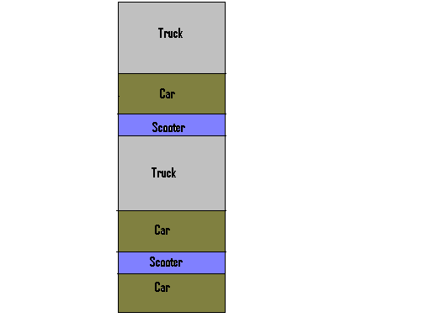
Memory Allocation Policies
Alongside is shown the partition in the parking area for Truck, Car and Scooter.
Now when a scooter, car and truck come in order, parking space is allocated according to algorithm policies
5
Problem statement: Stepwise description and illustrations (Add more slides if necessary)‏

Slide 10
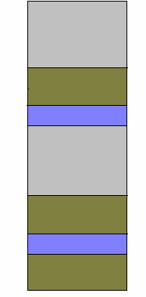



Worst Fit
Best Fit
Next Fit

Slide 11
Memory Allocation Policies
Now take another theoretical example.
Given the partition of 100K,500K,200K,300K,600K as shown, the different algorithms will place the processes 212K,417K,112K,426K respectively.
The request for 426K will be rejected in case of next fit and worst fit algorithm because any single partition is less than 426K

Slide 12
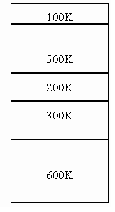
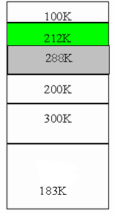
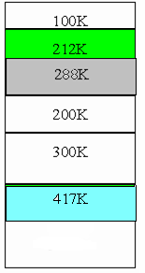




Next Fit (212k,417k,112k)
The request for 426K will be rejected
Similarly we cant implement for Other Two Policies

Slide 13
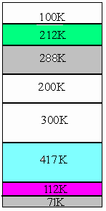
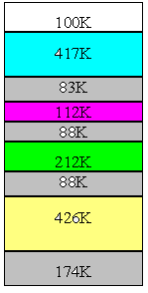
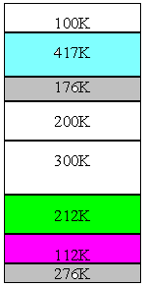

212K-Green
417K-Blue
112K-Pink
426K-Yellow
External Fragmentation-Gray
Unused Partitions-White
Next Fit
Best Fit
Worst Fit
7

Slide 14
Memory Allocation Policies
The animation would consist of rectangular block with predefined partitions of memory blocks representing the original memory.
The user would then input the number of processes and the process sizes. He/she will define the order in which the request will be made for allocation of memory. He / She will also define the allocation policy.
If the user does not wish to define the allocation policy, then, by default, the animation is created using the best policy suited.
8
List out user interactions that will be there to enhance the understanding of the concept in the animation.

Slide 15
Memory Allocation Policies
Three level of customization is done for user interactivity which is as follows:-
The color for unoccupied space is denoted by white, occupied space is denoted by black, and incoming process is shown by gray. After allocation that process is changed to black.
The algorithm can be specified by user for better understanding, otherwise, we show the animation according to best placement algorithm.
User can specify the partition to be dynamic or fixed. Dynamic partitioning can be implemented by taking user input of the start and end of each partition.
List out user interactions that will be there to enhance the understanding of the concept in the animation.

Slide 16
User selects the algorithm in order of worst fit, best fit and, next fit.
Worst Fit
Worst Fit
Next Fit
Best Fit
Best fit
Next Fit
100K
100K
100K
100K
100K
100K
100K
100K
100K
200K
200K
200K
200K
200K
200K
200K
300K
300K
300K
300K
300K
300K
300K
300K
300K
300K
300K
User input = 300K
process 100K
sizes 400K
400K
400K
100K
400K
100K
100K
400K
400K
400K
500K
500K
500K
500K
500K
500K
500K
100K
100K
100K
300K
300K
600K
600K
600K
600K
600K
600K
600K
300K
300K
List out user interactions that will be there to enhance the understanding of the concept in the animation.

Slide 17
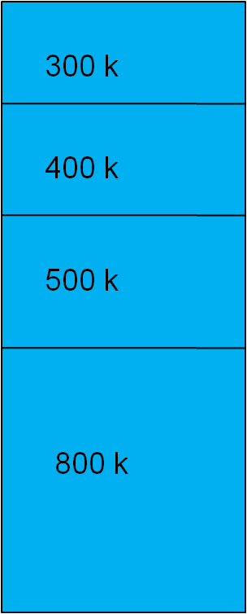
Dynamic memory Partitioning with User interactivity
User entered 5 processes which allotted in memory
Empty Memory
List out user interactions that will be there to enhance the understanding of the concept in the animation.

Slide 18


User Selected Best Fit
User entered 5 processes allotted in memory
Best Fit
New process given by user
450 k
450K
External Fragmentation
List out user interactions that will be there to enhance the understanding of the concept in the animation.

Slide 19
User Selected Worst Fit
User entered 5 processes allotted in memory
New process given by user
Worst Fit
450 k
450K
350K
External Fragmentation
List out user interactions that will be there to enhance the understanding of the concept in the animation.

Slide 20

User Selected Next Fit
User entered 5 processes allotted in memory
New process given by user
Next Fit
450 k
450K
External Fragmentation
List out user interactions that will be there to enhance the understanding of the concept in the animation.

Slide 21
Memory Allocation Policies
Which is the best placement algorithm with respect to fragmentation?
Worst-fit algorithm is the best placement algorithm with respect to fragmentation because it results in less amount of fragmentation.
Which is the worst placement algorithm respect to time complexity ?
Best-fit is the worst placement algorithm respect to time complexity because it scans the entire memory space resulting in more time.
9
A small questionnaire with answers based on the concept.

Slide 22
Memory Allocation Policies
Operating Systems Internals & Design Principles-William Stallings.
Operating System Concepts- Silberschatz, Galvin, Gagne.
Modern Operating Systems- Andrew S. Tanenbaum.
10
Links for further reading/references

Slide 23
Memory Allocation Policies
Concept proposed by:
1.Aniket Phatak.
2.Daishik Mehta.
3.Ameya Gawde.
11
Credits

